Slide 1
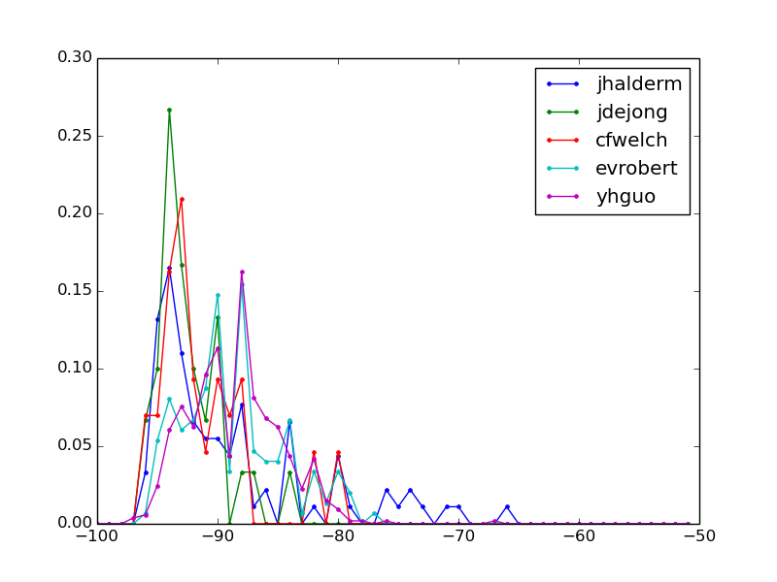
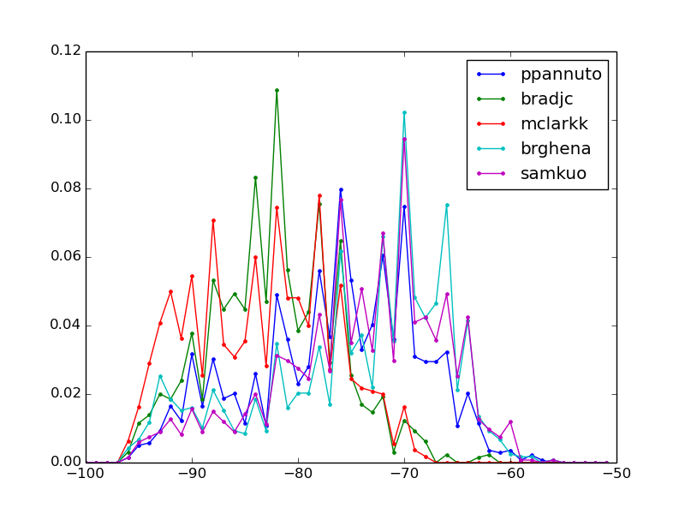
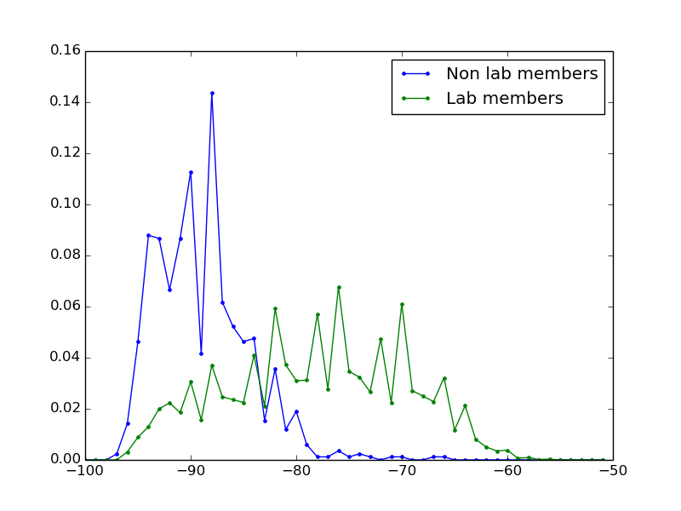
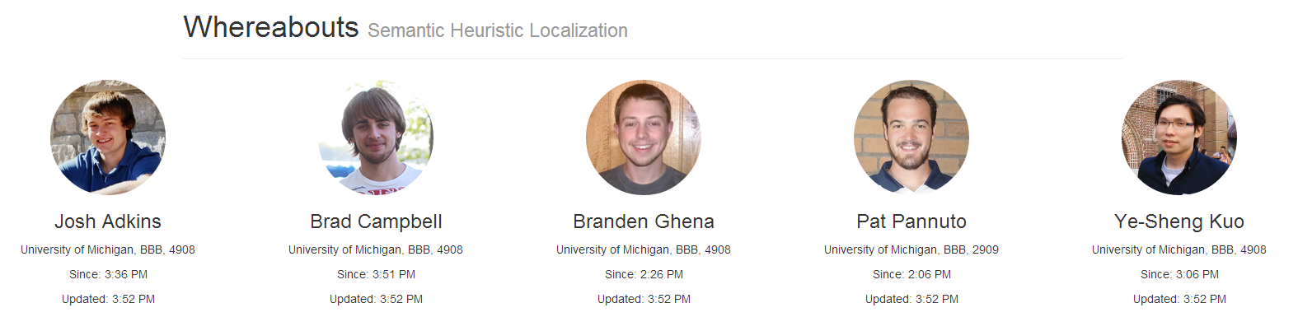
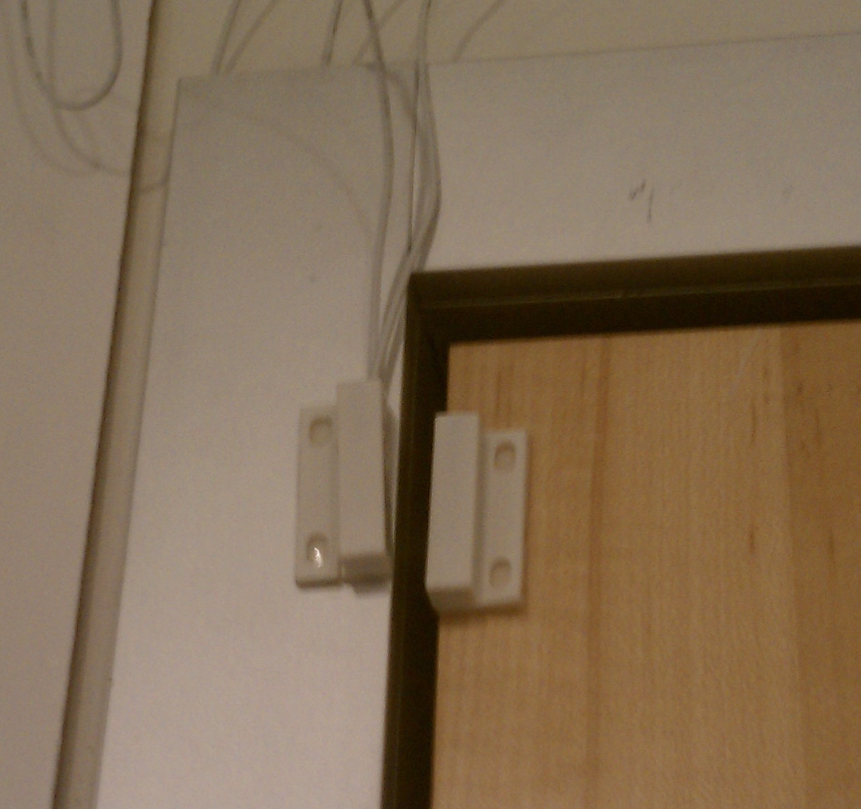
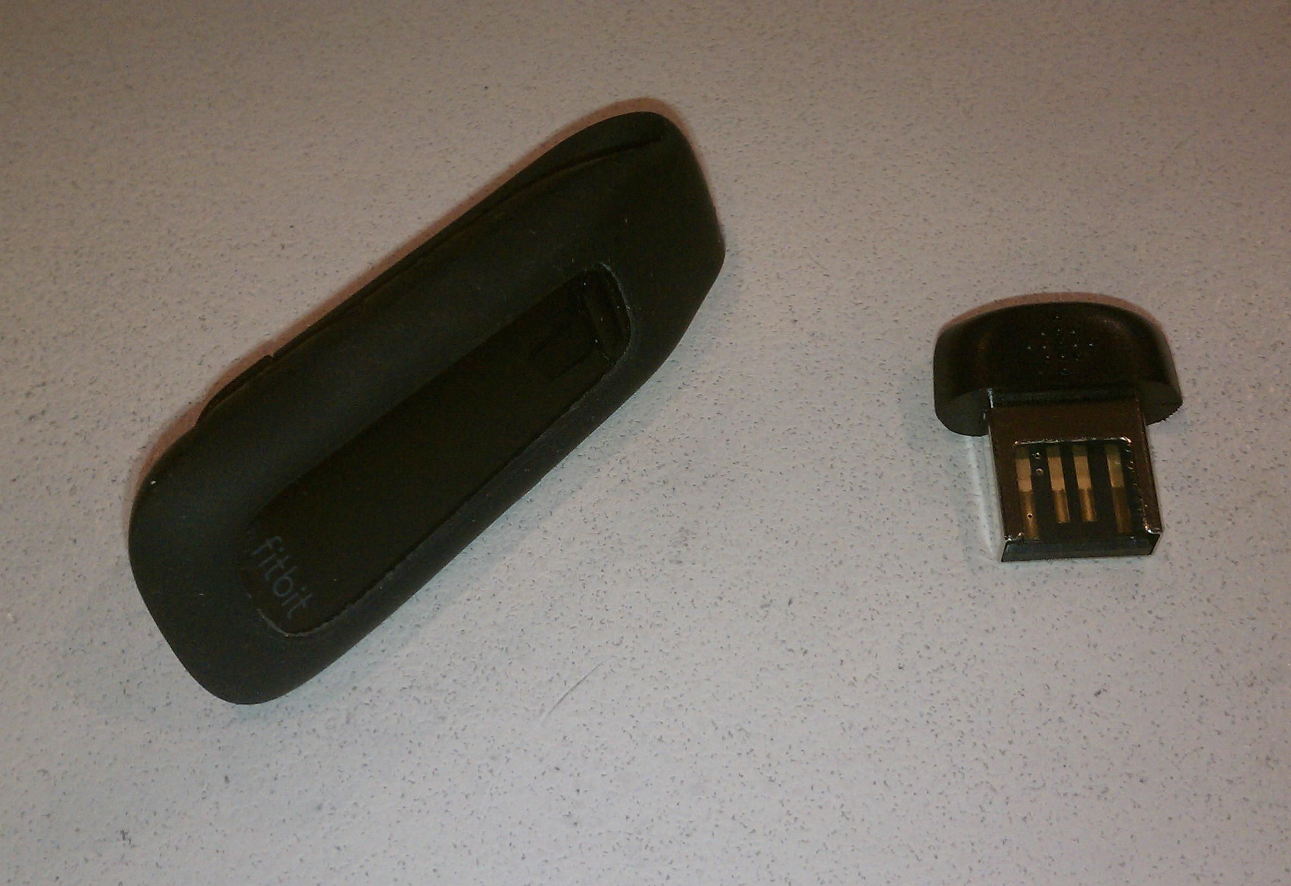
Whereabouts: Semantic Heuristic Localization
Branden Ghena, Meghan Clark, Prabal Dutta -
University of Michigan
Introduction
Whereabouts is designed to answer the question:
Who’s in Lab?
Semantic localization entails determining the location of one object relative to another:
On the counter
Next to the printer
In the room
It can be used in the context of indoor localization to determine which rooms individuals are in.
Our goal is to semantically localize people using only the things they already carry.
Whereabouts utilizes RSSI data from Fitbits, fitness sensors already worn by many individuals, in order to make a determination of an individual’s location and uses door access events as a trigger to perform intelligent scanning.
Other Building Occupants
Challenges
The Barrier Problem
Radio waves disobey semantic boundaries such as walls and floors, making location determinations difficult.
Distributions of probable RSSI values differ significantly between lab members and other building occupants. This allows for a probabilistic solution.
Coverage and Deployability Difficulties
Not all lab members own Fitbits and even those who do occasionally forget them.
One source of information is never enough to localize people. Whereabouts already incorporates data from door RFID entry. Future work will expand to include more sources of information such as:
Smartphone detection
Computer power usage
Voice detection
Future Work
Whereabouts is a solution to one part of the problem. The next step is to apply the localization information to do useful things.
Intelligent Building Controls
Occupant detection allows for more targeted control algorithms such as individualized temperature control, automatic device shutdown, and additional security systems.
Mapping Capabilities
Semantic localization can be used for indoor navigation based on an individual’s current location.
It can also be used to direct people to other people. Imagine a world where you could always find your advisor.
Probability of Occurrence
RSSI
Lab Members
Probability of Occurrence
RSSI
Not In Lab
In Lab
Probability of Occurrence
See the live demo:
inductor.eecs.umich.edu/whereabouts.html
-83
RSSI
Figure 1: Fitbit RSSI data measured over several weeks. Distributions between lab members and other individuals in the building are distinct, allowing RSSI to be used for approximate location.
Notes:
This is the revised version of the poster that was printed.

